Slide 1
Capturing Real World
Chapter - 4

Slide 2
Outlines
Different methods of data capture
Map projection and spatial reference
Data preparation, conversion & integration
Quality aspects of spatial data
GPS
Remote Sensing

Slide 3
Different methods of data capture
1

Slide 4
Stages in Data Collection Projects
establish user requirements
garnering resources
developing a project plan
Planning
identify project successes & failures
Preparation
Evaluation
obtain data & redraft poor quality map sources
edit scanned map images/removing noise
setup GIS h/w & s/w sys to accept data
Editing / Improvement
Digitizing / Transfer
covers many techniques designed to validate data
correct errors & improve quality
stage where the majority of the effort will be expended

Slide 5
Methods of data capture
One of most expensive GIS activities.
No single method of entering the spatial data into a GIS.
Several mutually compatible methods that can be used singly or in combination.
Choice of Data capture method depends on:
application used
available budget
type & complexity of data being input

Slide 6
Methods of data capture
GIS data capture is a technique in which the information on various map attributes, facilities, assets, and organizational data are digitized and organized on a target GIS system in appropriate layers.
Two broad types of collection:
Data capture (direct collection)
Data transfer
Two broad capture methods:
Primary (direct measurement)
Secondary (indirect derivation)

Slide 7
Data Collection Techniques
 | Raster | Vector
Primary | Digital remote sensing images | GPS measurements
 | Digital aerial photographs | Survey measurements
Secondary | Scanners | Topographic surveys
 | DEMs (Digital elevation model)from maps | Digitizing

Slide 8
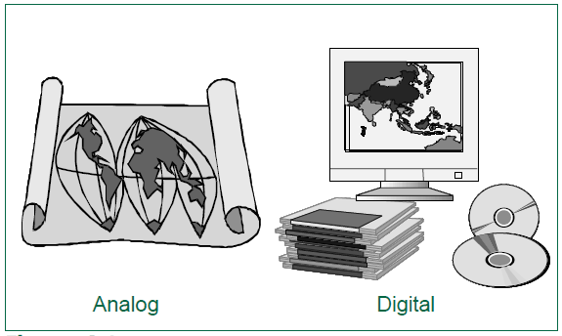
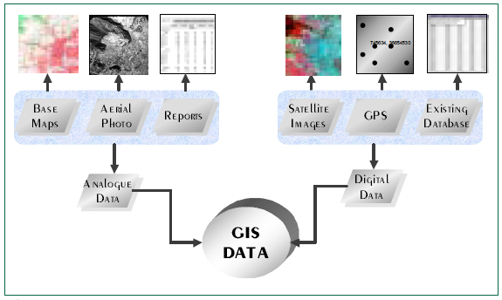
Data Collection Techniques

Slide 9
Primary GIS data capture
Raster Data capture:
Remote sensing
Aerial photography
Vector Data capture
Surveying
LiDAR(Light detection and ranging)
GPS

Slide 10
Raster Data capture
Remote Sensing:
technique used to derive information about the physical, chemical, & biological properties of an objects without direct physical contact.
information is derived from measurements of the amount of electromagnetic radiation reflected, emitted, or scattered from objects.
resolution is a key physical characteristic of remote sensing systems.

Slide 11
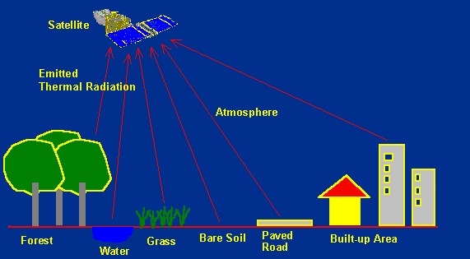
How Remote Sensing works?
Notes:
Different materials such as water, soil, vegetation, buildings and roads reflect visible and infrared light in different ways.
They have different colours and brightness when seen under the sun.

Slide 12
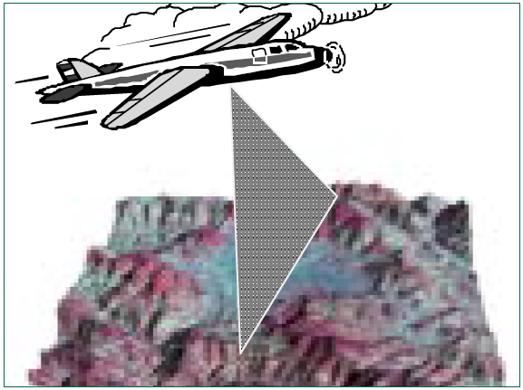
Raster Data capture
Aerial Photography:
Aerial photography is equally important in medium- to large-scale projects
Photographs are normally collected by analog optical cameras and later scanned
The process involves using specialized equipment (a stereo-plotter) to project overlapping aerial photos so that a viewer can see a 3-D pictures of the terrain.
This is known as photogrammetric model.

Slide 13
Raster Data capture
Aerial Photography (Advantages):
Consistency of the data
Availability of systematic global coverage
Regular repeat cycles
Aerial Photography (Disadvantages):
Resolution is often too coarse
Many sensors are restricted by cloud cover

Slide 14
Vector Data capture
Surveying:
surveying is based on the principle that the 3-D location of any point can be determined by measuring angles and distances from other known points.
Ground survey is a very time-consuming and expensive activity, but it is still the best way to obtain highly accurate point locations.
Typically used for capturing buildings, land and property boundaries, manholes, and other objects that need to be located accurately.
Also employed to obtain reference marks for use in other data capture projects

Slide 15
Vector Data capture
LiDAR:
Relatively new technology that employs a scanning laser rangefinder to produce accurate topographic surveys
Typically carried on a low-altitude aircraft that also has an inertial navigation system and a differential GPS to provide location.

Slide 16
Vector Data capture
GPS:
Collection of satellites used to fix locations on Earth’s surface
Differential GPS used to improve accuracy
Precise positioning is possible using GPS receivers at reference locations providing corrections and relative positioning data for remote receivers.
GIS mapping data capture, surveying engineering and geodetic control are the main disciplines for GPS for precise positioning(upto mm level)

Slide 17
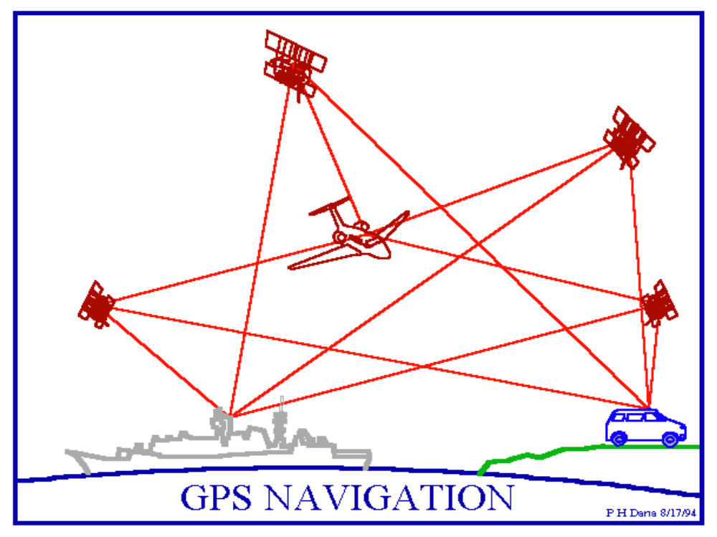
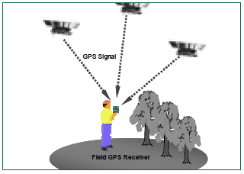
Vector Data capture : GPS

Slide 18
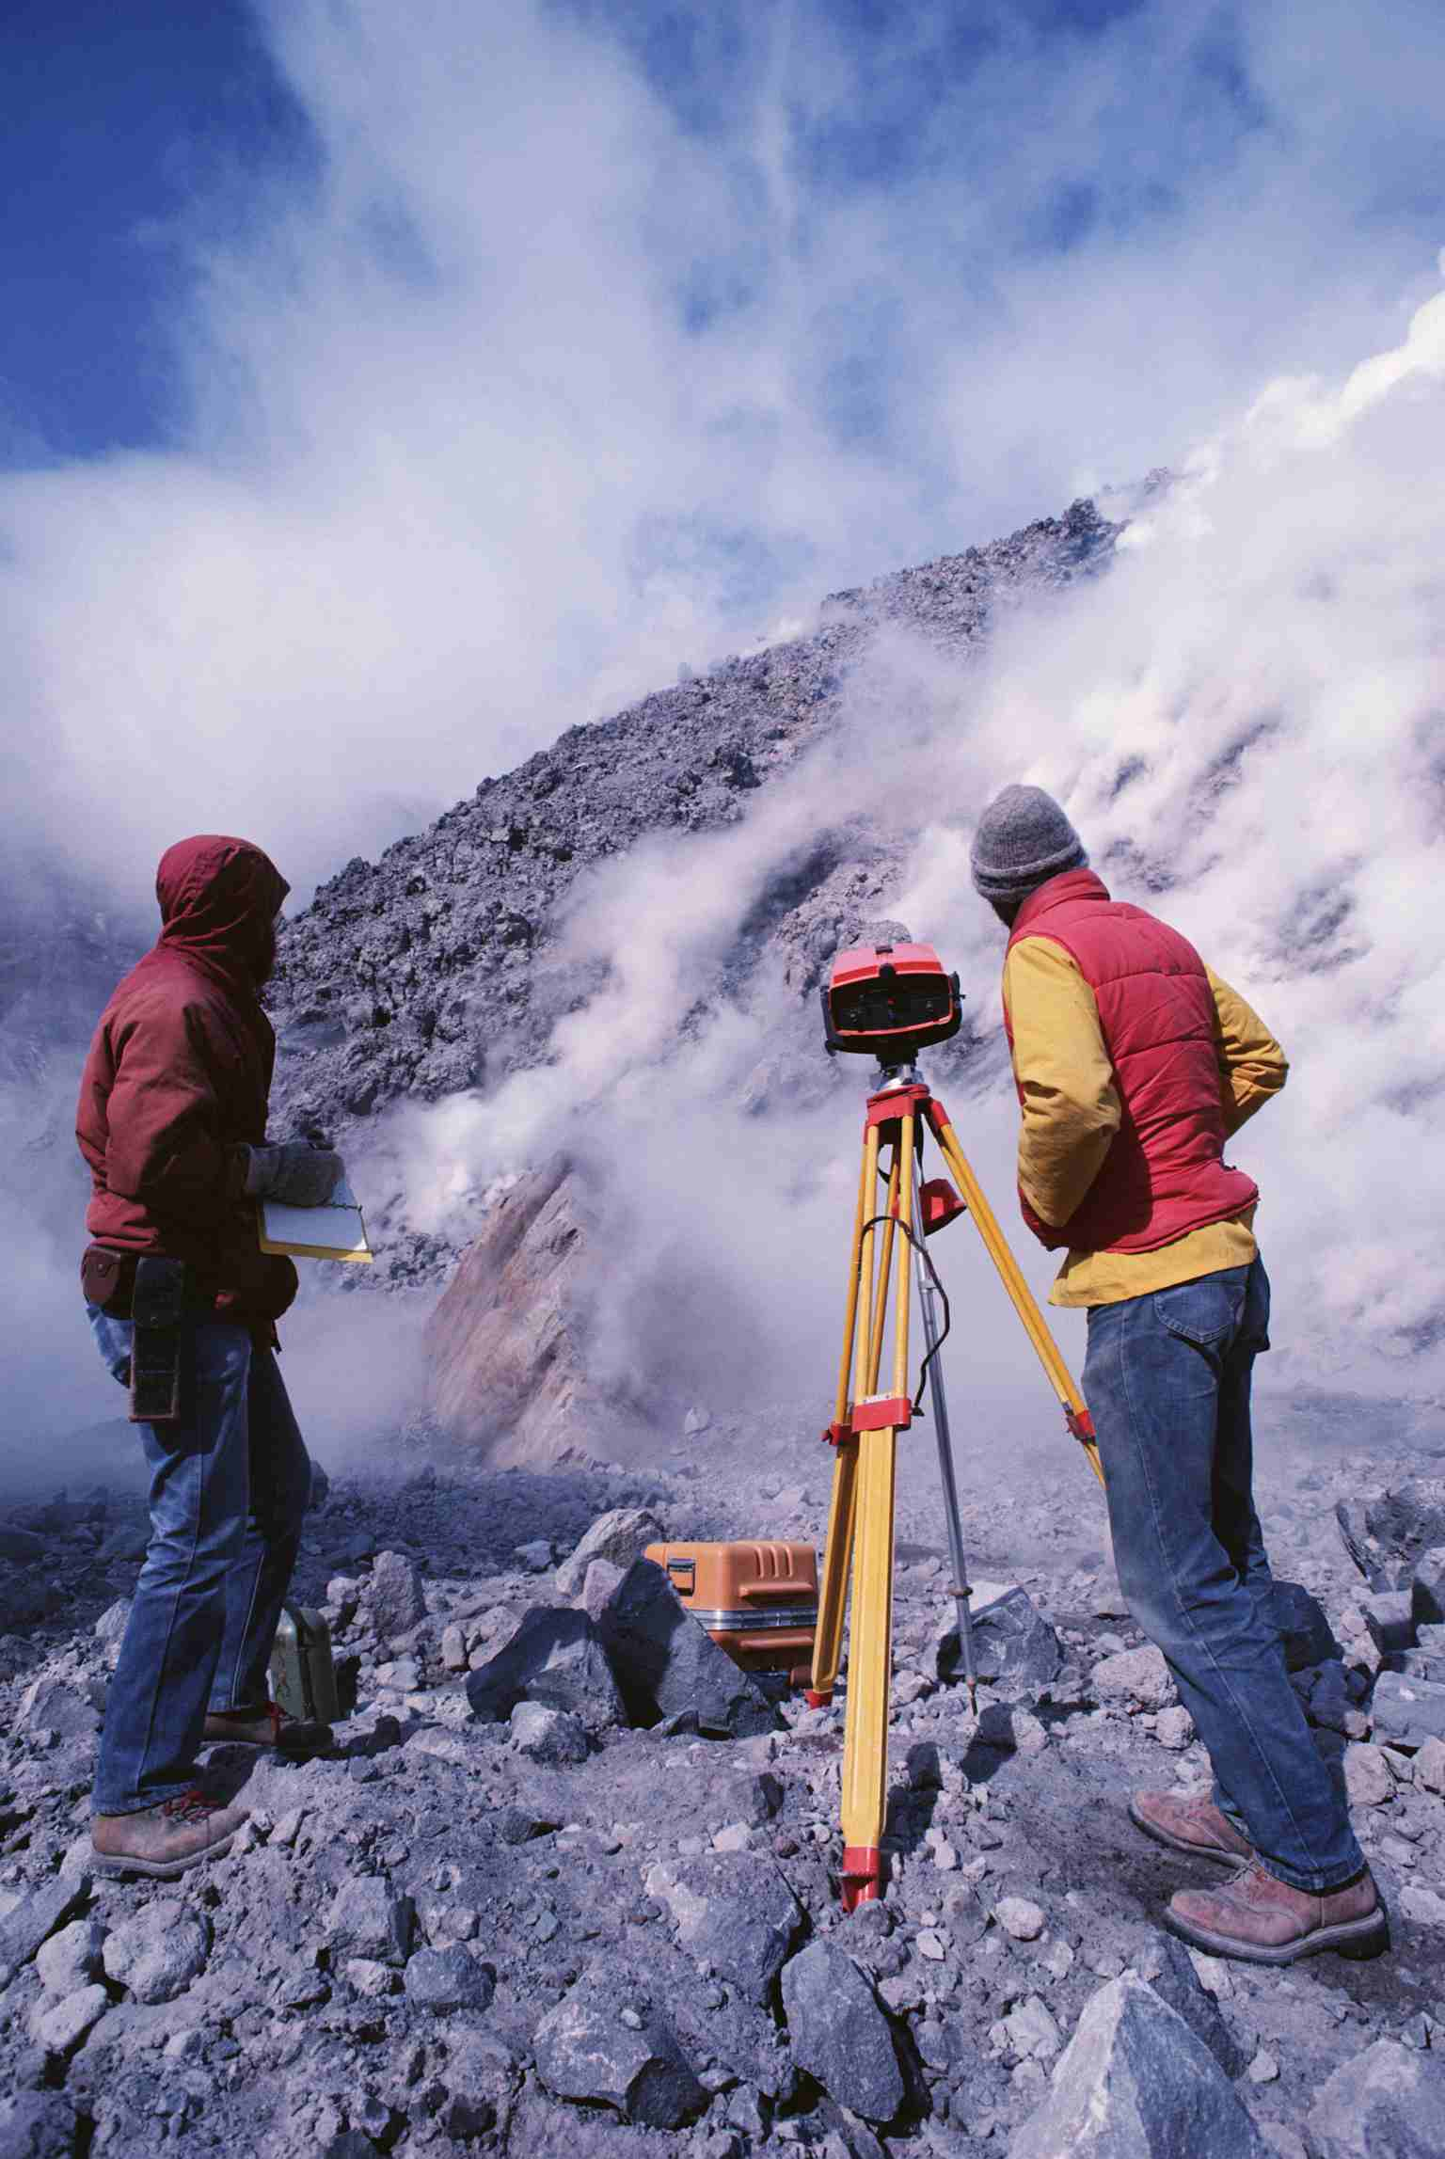
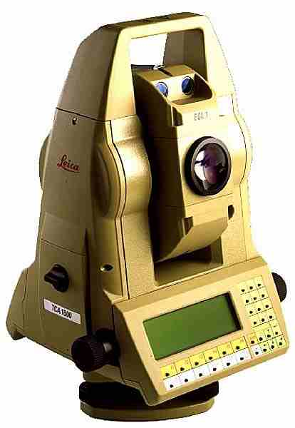
GPS: Total Station

Slide 19
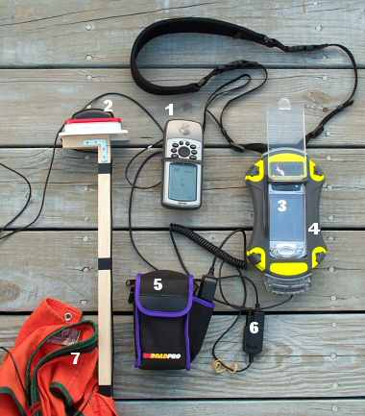
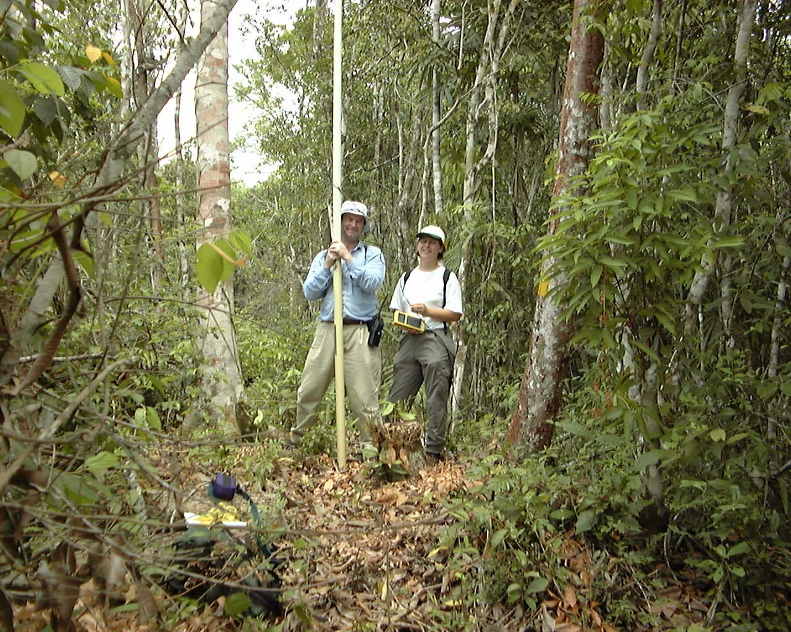

GPS: Pen/Portable PC

Slide 20
Secondary GIS data capture
Raster Data capture:
Scanners
Vector Data capture
Digitizing

Slide 21
Raster Data capture
Scanners:
Documents are scanned to reduce wear and tear, improve access, provide integrated database storage, and to index them geographically
Film and paper maps, aerial photographs, and images are scanned and georeferenced so that they provide geographic context for other data
Maps, aerial photographs and images are scanned prior to vectorization
Most scanning systems provide software to convert raster data to vector format that differentiates points, line and area features

Slide 22
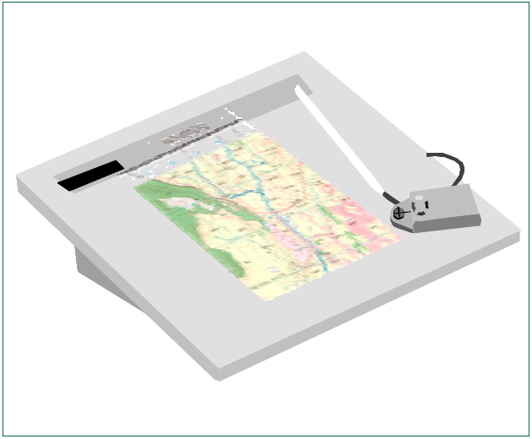
Vector Data capture
Digitizing:
Digitizing workstation with digitizing tablet and cursor is typically used to trace digitize.
Both the tablet and cursor are connected to computer that controls their functions.
Most digitizing tables come in standard sizes that relate to engineering drawing(A-E & larger)
The person performing the digitizing may input separate features into map layers or attach an attribute to identify the feature.

Slide 23
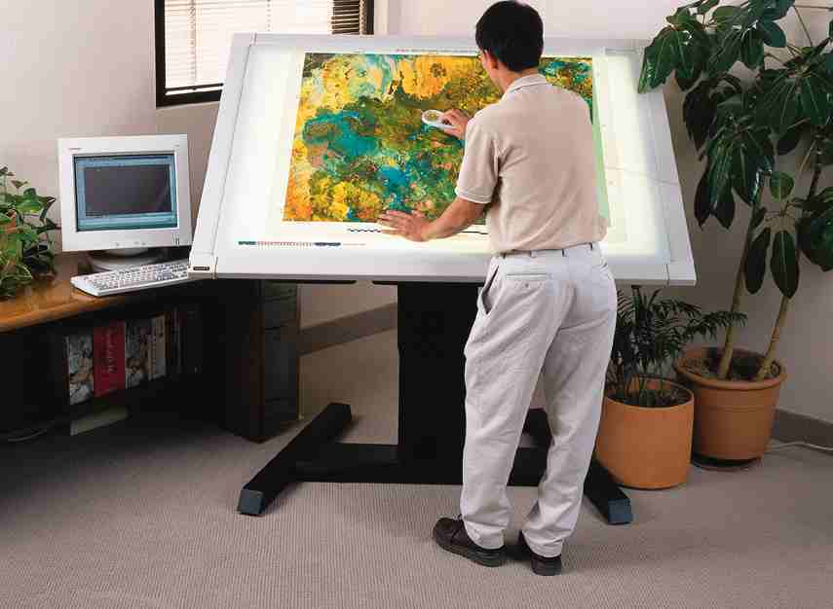
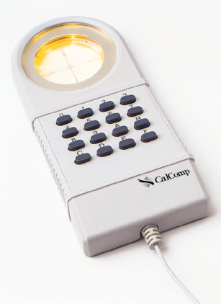
Vector Data capture: Digitizer

Slide 24
Data Preparation and
Integration
1

Slide 25
Necessary steps
Geocoding: assigning geo-coordinates to points
most basic form of spatial data entry
data media conversion
Scanning
digitizing
data format conversion
raster & vector
data reduction
Topology, error detection and topological editing

Slide 26
Necessary steps
rectification and registration (one on top of the other)
overlaying sheets and referencing to the real world
edge matching & image adjustment (side by side)
linking & balancing adjacent sheets
Interpolation (a remark interjected in a conversation.)
Conflation (the merging of two or more sets of information, texts, ideas, etc. into one.)

Slide 27
Step 1: Geocoding
Assigning spatial coordinates to point data
Address Matching:
assigns spatial coordinates (explicit location) to addresses (implicit location)

Slide 28
Step 2: Data Media Conversion
Scanning
Produces “dumb” raster data
  scan resolution depends on price!
Digitizing
Applied to map or aerial photo
essentially a vector approach
map errors transferred to GIS

Slide 29
Step 3: Data Format Conversion
Vector raster
Vector to Vector
Raster to Raster
Vector to Raster
Raster to Vector
vector
raster
4 possibilities

Slide 30
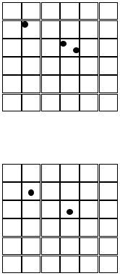
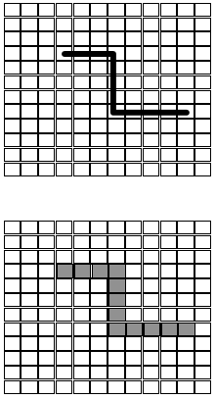
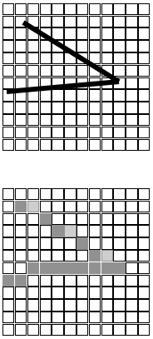
Vector to Raster Conversion
Diagonal Line
(more problemmatic)
Point
Orthogonal Line
Vector
Raster

Slide 31
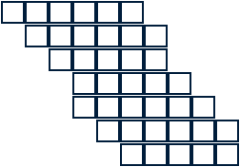
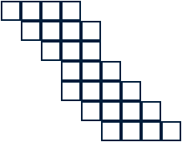
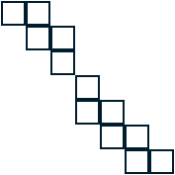
Raster to Vector Conversion
Skeletonizing

Slide 32
Data Format Conversion Implementation in ArcGIS 9
To Raster
To Vector
Arctoolbox>Conversion Tools>To Raster> Raster To Other (multiple) Converts one or more raster dataset formats supported by ArcGIS to a GRID, IMAGINE, TIFF, or geodatabase raster dataset format Can also be accomplished thru ArcCatalog, Export function | Arctoolbox>Conversion Tools>From Raster> Raster to Point Raster to Polygon Raster to PolyLine Converts raster datasets in GRID, IMAGINE, or TIFF formats to shapefiles or feature classes. Results may not be what you expect! Can also be accomplished thru ArcCatalog, Export function
Arctoolbox>Conversion Tools>To Raster> Feature to Raster Converts any shapefile, coverage, or geodatabase feature class containing point, line, or polygon features to a raster dataset Can also be accomplished thru ArcCatalog, Export function. | Use ArcCatalog, Export function for conversions between shapefiles, gdb feature classes, coverages and CAD ArcGIS Data Interoperability Extension for the most comprehensive set of conversions
From
Raster
From
Vector

Slide 33
Step 4: Data Reduction
Why?
conserve space
Disk in past / bandwidth today
conserve time
reduce processing time (batch) / speed response time (interactive)

Slide 34
Step 4: Data Reduction
3
7
16 bytes
2
4
4 bytes
1 byte
4
Why?
conserve space
Disk in past / bandwidth today

Slide 35
Step 5: Error detection & removal
GIS packages commonly use topological structure checking to detect errors
Editing based on node snapping used to correct errors: moving a feature so its coordinates correspond exactly with another’s

Slide 36
Step 6: Rectification and Registration
Rectification: Rearrangement of location of objects to correspond to a specific reference system.
Registration: Rearrangement of location of objects of one set so they correspond with those of another, without reference to a specific reference system

Slide 37
Step 6: Rectification and Registration
Two Methods:
homogeneous transformation via rotation, translation, scaling, skewing
used for map projection and similar conversions
differential transformation via rubber sheeting
used to correctly position distorted images or scanned maps or documents

Slide 38
Step 7: Edge Matching
Process
required for topo. consistency even if features line-up visually
Issues
acceptable tolerance before ‘further investigation’ of mismatch
‘how far back’ to go on sheet(s) with adjustments for mismatch
Causes of mismatch
paper map shrinkage/expansion
errors from digitizing/scanning
Corresponding features fail to match on two sheets:
Edge matching in this example
would require ‘further research’

Slide 39
Step 8: Interpolation
estimating values for locations with no data based on:
  known values, and
  understanding of spatial behavior of phenomena
generally, should assign more importance to closer known values than those further away
Estimated values
Implemented in ArcGIS 9 via ArcToolbox>Spatial Analyst Tools>Interpolation

Slide 40
Step 9: Conflation
create new master coverage from the best spatial and attribute qualities of two or more source coverages
  combine multiple coverages into one to simplify support
  updated data obtained (e.g. new TIGER file) but need to preserve enhancements made to earlier version
  two groups modify a single file, then need to recreate single version which preserves mods
create new master coverage from quality spatial data in one source and quality attribute data in another
  somewhat narrower definition
Depending on the situation, can require application of a variety of processing tools and can be labor intensive:
Approaches available within ArcGIS 9 include
  Spatial Adjustment toolbar, specifically attribute transfer tool
  ArcToolbox>Analysis Tools>Overlay>Update
other add-ins

Slide 41
Map projection and
Spatial reference
1

Slide 42
Map projection
1

Slide 43
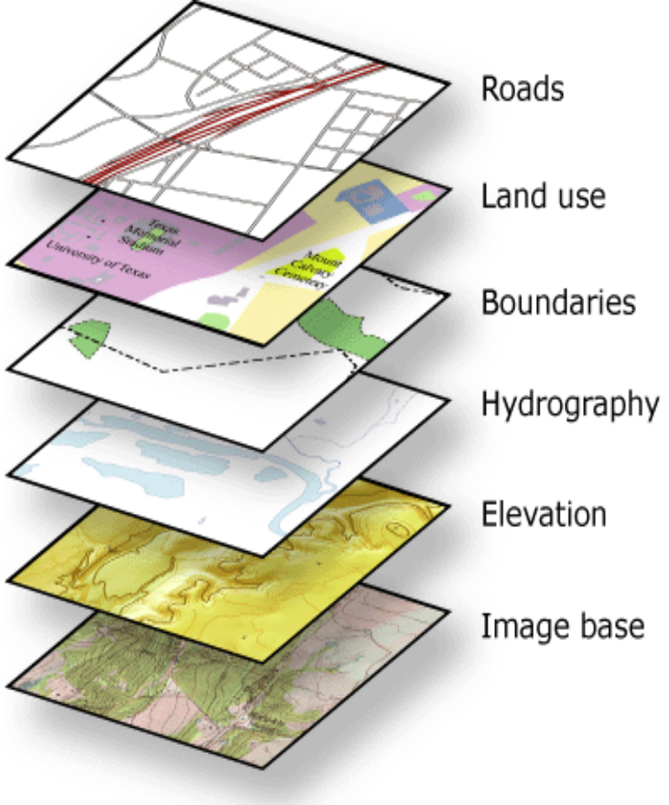
Map Projection
Every dataset has a coordinate system, which is used to integrate it with other geographic data layers within a common coordinate framework such as a map.
A map projection is defined by
name of projection
type of projection (e.g. cylindrical - using different reference bodies)
description (applicable parameters depend on type of projection)
ellipsoid / datum parameters

Slide 44
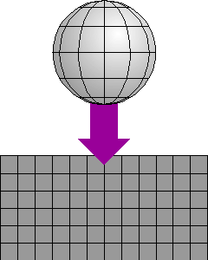
Map Projection
is a mathematical formula for representing the curved surface of the earth on a flat map.
Every projection has its own set of advantages & disadvantages.
There is no "best" projection.
Mapmakers and mathematicians have devised almost limitless ways to project the image of the globe onto a flat surface (paper).

Slide 45
Map Projection
The creation of a map projection involves three steps:
Selection of a model for the shape of the Earth:
usually choosing between a sphere, ellipsoid, geoid.
Because the Earth's actual shape is irregular, information is lost in this step.
Transformation of geographic coordinates:
(long/lat) to Cartesian (x, y) or polar plane coordinates.
Cartesian coordinates normally have a simple relation to eastings and northings defined on a grid superimposed on the projection.
Reduce the scale:
in manual cartography this step came second, in digital cartography it comes last

Slide 46
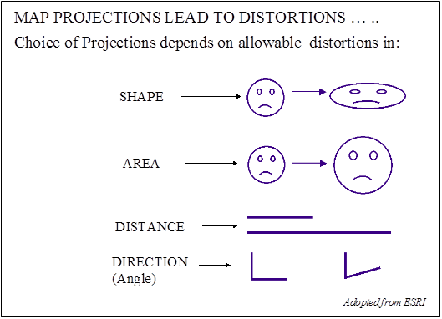
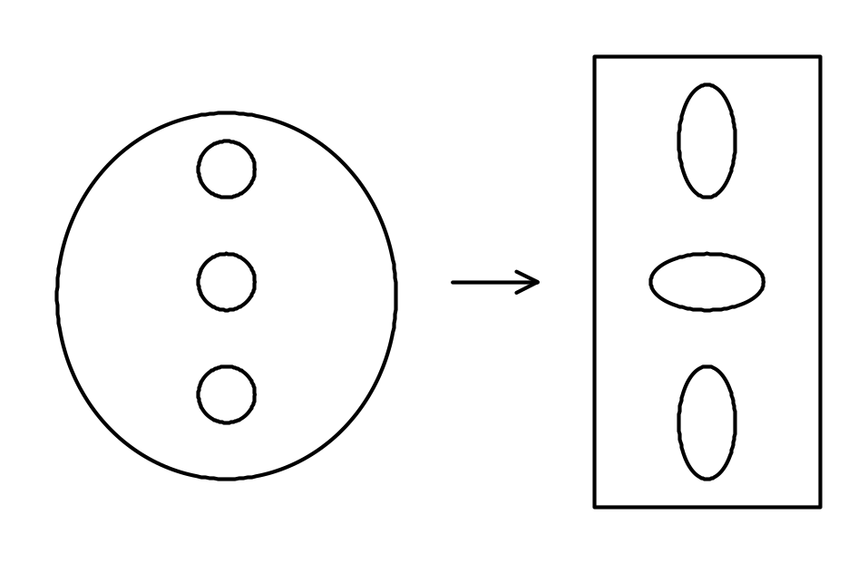
Distortions
Distortions are inherent in maps
This process of flattening the earth will cause distortions in one or more of the following spatial properties:
Distance
Area
Shape
direction

Slide 47
Map Projections Parameters
Standard Line – line of tangency - where the projection surface meets the globe
No distortion at this point – increase distortion moving away
Standard Parallel
Standard Meridian
More than one standard line possible
Central Line
Defines the center of the map projection
Central parallel - latitude of origin
Central meridian
Can be different from standard line
False Easting – x- coordinate value
False Northing – y- coordinate value

Slide 48
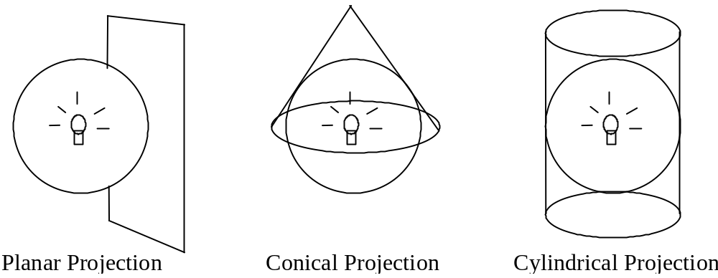
Map Projections Types

Slide 49
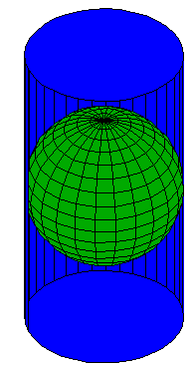
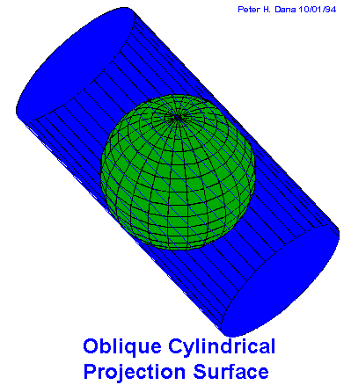
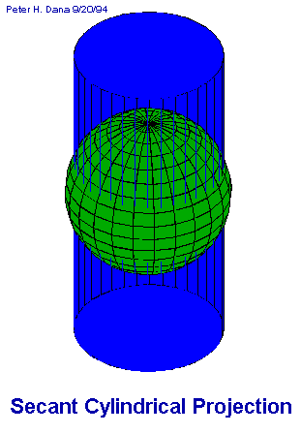
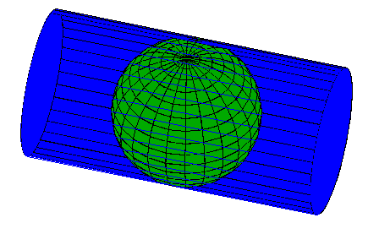
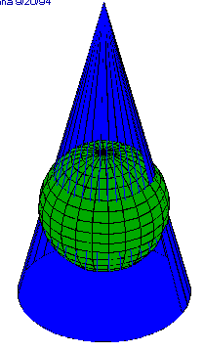
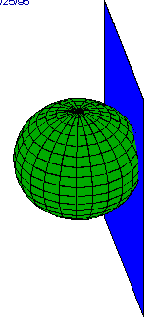
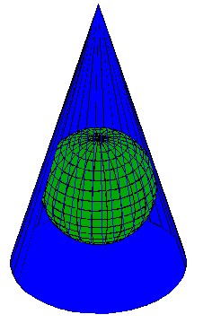
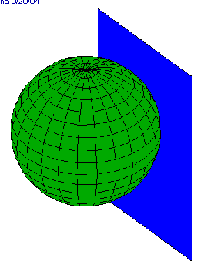
Transverse Cylindrical
Oblique Cylindrical
Secant Cylindrical
Cylindrical
Conical
Secant Conical
Azimuthal or Planar
Secant Planar
Notes:
Cylindrical projections, are analogous to wrapping a cylinder of paper around the earth, projecting the earth’s feature onto it, and then unwarpping the cylinder.
Conic projections, are analogous to wrapping a sheet of paper around the Earth in a cone, projecting the earth’s feature onto it, and then unwarpping the cone.
Azimuthal or planar projections, are analogous to touching the earth with a sheet of flat paper,
Central meridian, standard meridians
Central parallel, standard parallels.

Slide 50
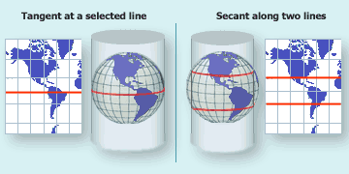
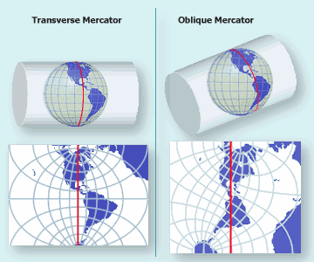
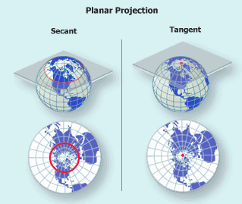
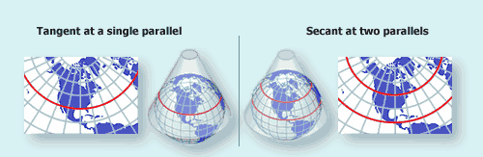
Map Projections Types

Slide 51
Types of projections
Important types of projections are:
planisphere:
whole earth is “unwrapped“ onto a plane one way or another
azimutal:
part of earth‘s surface is projected onto a plane
conical:
part of earth‘s surface is projected onto a conical shape and then flattened
cylindrical:
same thing with a cylindrical shape

Slide 52
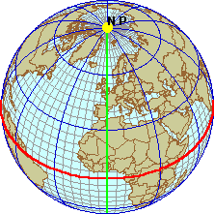
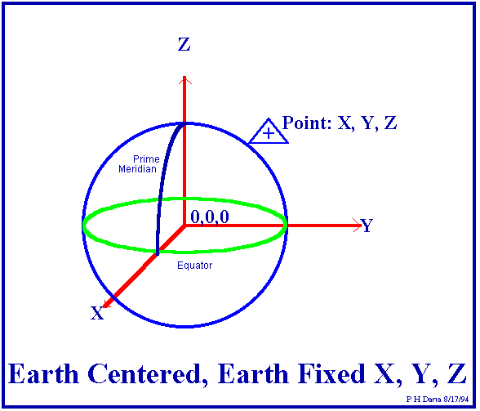
Spatial Reference
Every spatial feature needs to be referenced to a location for GIS use.
Spatial reference systems provide a framework to define positions on the Earth‘s surface.
We are used to working with coordinate systems, but due to the Earth‘s irregular, spherical shape this can become intricate.

Slide 53
Spatial Reference Systems
Clear definition scheme required for geodata exchange and interoperability
This description needs to be coupled to geodata by sets of metadata
to permit flexible georeferenced visualization
to permit correct measurements
to permit operations between datasets based on different reference systems
Notes:
Think about a building construction plan: if the overall spatial reference system is not clearly and completely defined, the construction company would not be able to put the new building in the correct location and orientation.
To put the construction plan onto a large scale topographical map or a city map (e.g. 1:10000), all involved geospatial documents need to have a defined georeferencing system, otherwise they are not „inter-operable“.
We can identify a number of reasons why defined georeferencing is ALWAYS required:
geospatial data sets from different sources can only be co-registered on a screen or hardcopy map if they are (automatically) transformed into the map‘s projection
measuring location, distance, bearing or area on any map is only feasible if the referencing system and its geometric properties are known
overlaying and other operations involving multiple data sets (map algebra: zonal and local operations) is only possible under the same conditions

Slide 54
Coordinate systems
Rules for identifying the position of each point in space by an ordered set of numbers:
Systems:
Cartesian: coordinate values locate a point in relation to mutually perpendicular axes
Polar: coordinates locate a point by angular direction(s) and distance from center.
Spherical: point on surface located by angular measurements from center (latitude, longitude)

Slide 55
Coordinate system
Coordinate systems are defined by:
number of dimensions (1, 2 or 3)
sequence/name of coordinate values (x, y, z)
unit scaling factor and system (meters)
origin of axes
direction of axes
Coordinate systems can be based on a geodetic reference (datum) and a map projection
Notes:
Various types of coordinate systems can be used, e.g.
two- or three-dimensional cartesian coordinate systems
two-dimensional geographical (spherical) coordinate systems
three-dimensional geodetic coordinate systems with ellipsoidal height
The sequence (x,y vs y,x) and naming of axes(N, Northing, Up) often has to be agreed between exchange partners.
Most parameters of specific coordinate systems are a direct result of the geodetic datum and (even more so) the map projection being used.

Slide 56
Direct vs. Indirect Positioning
Two methods to position points relative to the surface of the Earth:
direct position:
position based on coordinates
indirect position:
position not using coordinates (e.g. street address)
P(10,15)
#17
Notes:
Direct position
direct position is a set of coordinates usually based on a spatial reference system which includes a geodetic datum and a coordinate system. It can also be a set of coordinates based on a local reference system, using a horizontal surface through a starting point.
Indirect position
in daily life and communications various kinds of positioning systems are used without using coordinates. These are street address, postal zone, place names etc. To communicate position this way, a common understanding between sender and recipient is required. In order to relate between different (direct and indirect) spatial reference systems and to support computer based handling, indirect position needs to be translated into defined coordinate systems (direct position). The term GEOCODING is used for this process.

Slide 57
2D vs. 3D systems
Most GIS are 2D or 2.5D
Many GIS operations are not defined in 3d space
Increasingly, we need to handle 3D data, even if we don‘t fully use them
Visualisation of 3D data sets is currently more important than analysis
Notes:
Overall, GIS methodology is largely ill defined in full 3D space. Still, from a perspective of interoperability we need to least gracefully handle 3D info instead of ignoring the vertical (z) component - as currently happens in many exchange interfaces.
As a compromise, some systems are capable of handling 2.5D info: elevation info is kept as an attribute, and on surfaces there is only one z-value per x,y position: thus the surface is „single-valued“, showing no folds etc
Vector data can be easily extended into 3D space by using coordinate triplets instead of pairs, from raster pixels we move on to „voxels“ - cubes from which volume objects can be constructed. Increasingly visualisation tools within GIS are capable of handling and properly displaying 3D data in various perspectives.
Again, we need to keep in mind that this trend is valid for data structures and visualisation, but currently not for the bulk of analytical functionality within GIS.

Slide 58
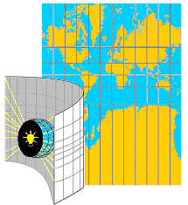
Geographic vs. Projected Coordinate System
GCS:
Location measured from curved surface of the earth
Measurement units: Lat/Lon
Degrees-minutes-seconds (DMS)
PCS:
Flat surface
Units can be in meters/feet/inches
Distortions will occur, except for very fine scale maps

Slide 59
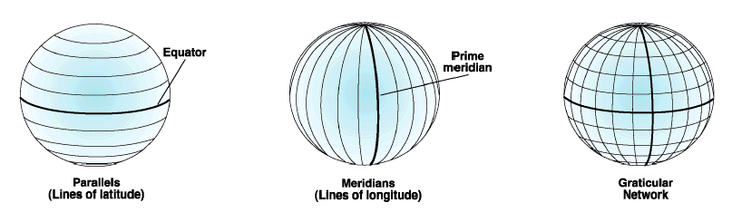
Geographic Coordinate System
Parallels: east to west – 0° at the Equator (0 °-90 °)
Meridians: north to south – 0° at the Prime Meridian (0 °-180 °)
Latitude and longitude are angular measurements made from the center of the earth to a point on the surface of the earth

Slide 60
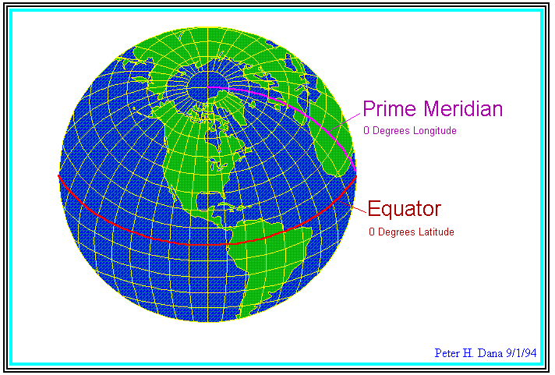
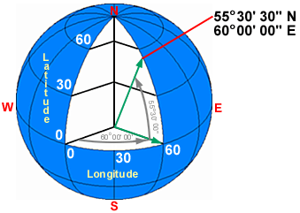
Globe
Spherical Earth’s surface
Radius 6371 km
Meridians (lines of longitude)
Passing through Greenwich, England as prime meridian or 0º longitude.
Parallels (lines of latitude)
Using equator as 0º latitude.
Degrees-minutes-seconds (DMS),
Decimal degrees (DD)
True direction, shape,
distance, and area
Notes:
degrees-minutes-seconds (DMS), MSEC GPS result: 34º04'04.270" N, 106º54'20.870 “ W
decimal degrees (DD): 34.06785 N, 106.90580 W
Parallels are parallel and spaced equally on meridians. Meridians and other arcs of great circles are straight lines (if looked at perpendicularly to the Earth's surface). Meridians converge toward the poles and diverge toward the Equator.
Meridians are equally spaced on the parallels, but their distances apart decreases from the Equator to the poles. At the Equator, meridians are spaced the same as parallels. Meridians at 60° are half as far apart as parallels. Parallels and meridians cross at right angles. The area of the surface bounded by any two parallels and any two meridians (a given distance apart) is the same anywhere between the same two parallels.
The scale factor at each point is the same in any direction.

